Slide 1
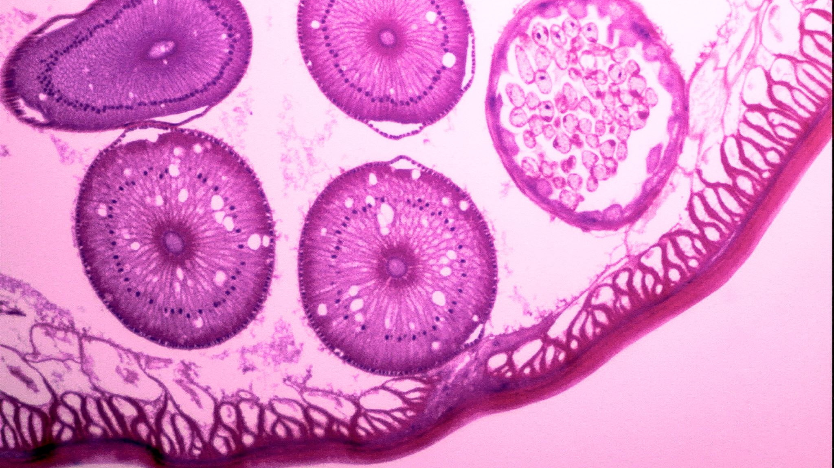
Liver Cirrhosis Survival Prediction
Data Mining & Machine Learning
Project

Slide 2
Introduction
The main goal of this project is to analyze the performance of different classifiers, in order to understand which one is able to predict the current survival chance of a patient, given that he/she currently has some degree of illness.

Slide 3
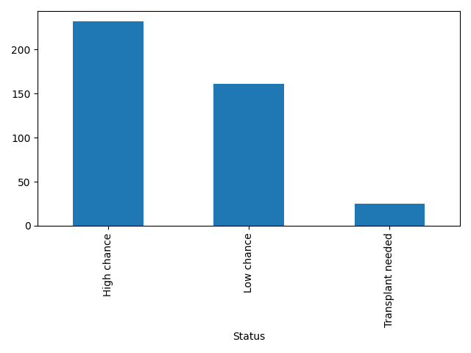
Dataset Description
20 Columns, 19 features and 3 labels: C, CL, D;
Mixed dataset, both categorical and numerical features;
Very small dataset, only 418 instances, some of which have NULL values inside;
Imbalanced class labels.

Slide 4
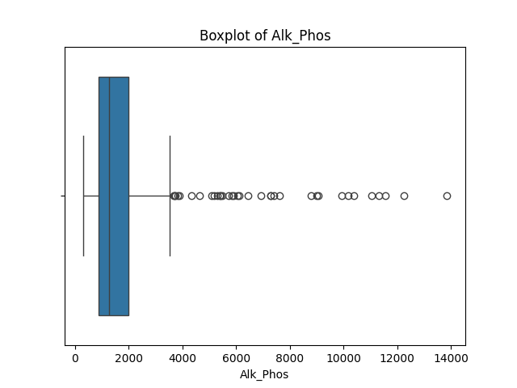
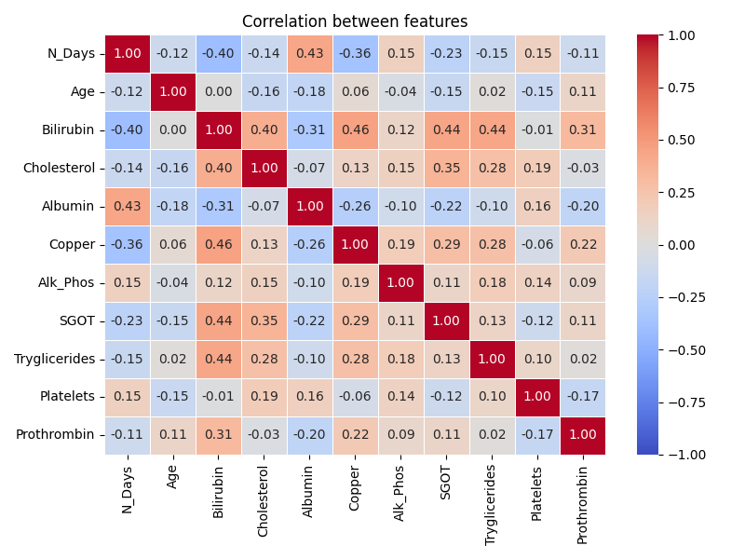
Preliminary Adjustments and Plots
C (censored), CL (censored due to liver trasplant) and D (dead) where changed to High Chance, Trasplant Needed and Low Chance; also the Age was converted to years. This two changes where done for a better visualization.
ID was dropped.
Since Stage is a «name», even if numerical, it was converted to categorical, as well as all the «object» features.

Slide 5
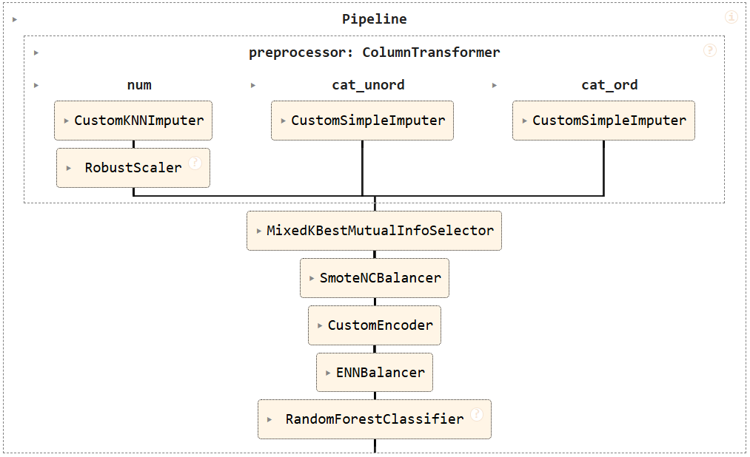
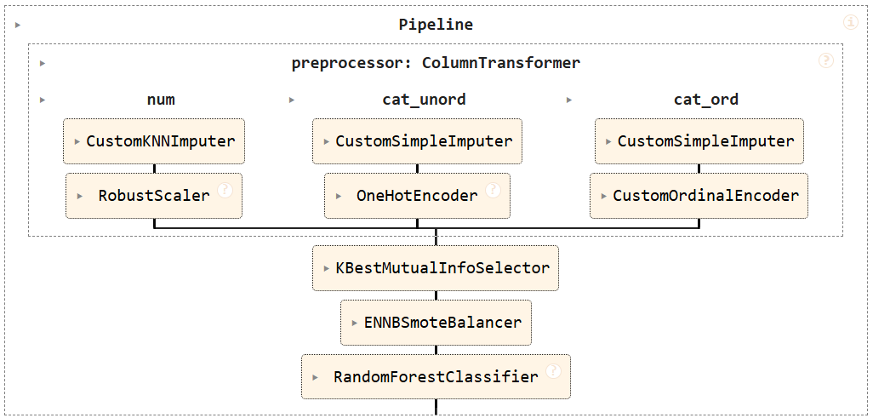
Pipelines
The two proposed pipelines exploits different tools, in order to test if mantaining categorical features as long as possible in the preprocessing (since at the end we are forced to convert them to numerical) leads to better results.

Slide 6
Pipelines Key Features
Features are divided in numerical, categorical ordered (given the seriousness of the symptom) and unordered (sex and drug used for medication);
Custom imputers take in consideration the class labels;
Since the SelectKBest with the mutual information compare a single numerical feature against the class labels (MI(C, f_i)), in the mixed version, for the remaining categorical features, the mutual information was calculated separately;
SMOTENC vs BorderlineSMOTE.

Slide 7
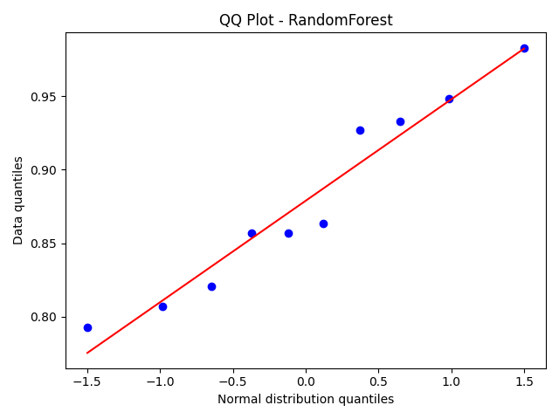
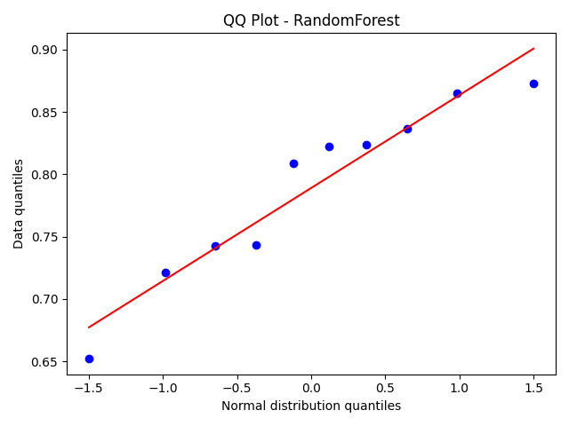
Models and Tests
Utilized models: Random Forest, AdaBoost with Naive Bayes Classifier, KNNeighbour and Logistic regression;
Utilized metric: f1_score average;
Randomized Cross Validation (10 folds) and Kruskall-Vallis test (non-parametric).

Slide 8
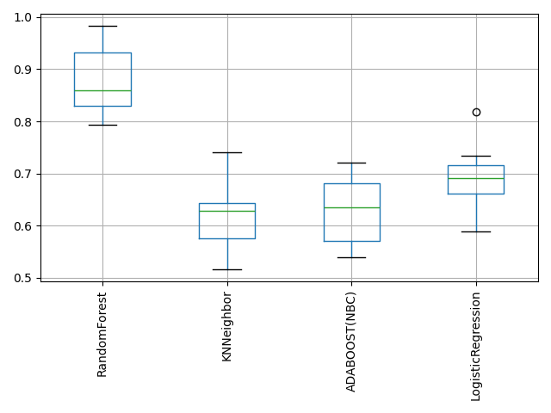
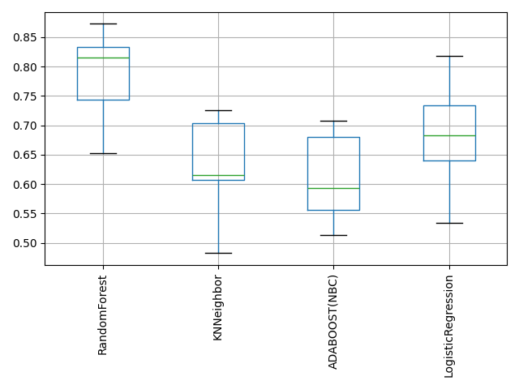
Final Results
Non SMOTENC { ’sampler__k_neighbors_cleaning’: 3, ’sampler__k_neighbors_borders’: 7, ’preprocessor__num__imputer__n_neighbors’: 11, ’feature_selector__k’: 14, ’classifier__max_depth’: 7, ’classifier__criterion’: ’entropy’ }
SMOTENC { ’sampler2__k_neighbors_cleaning’: 3, ’sampler1__k_neighbors’: 8, ’preprocessor__num__imputer__n_neighbors’: 15, ’feature_selector__k_num’: 11, ’feature_selector__k_cat’: 2, ’classifier__max_depth’: 5, ’classifier__criterion’: ’gini’ }

Slide 9
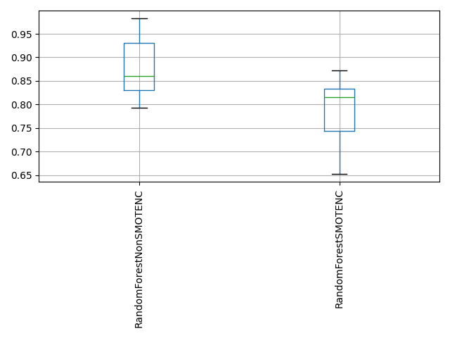
Further Testing
NonSMOTENC performs better than SMOTENC

